Slide 1




CALIFORNIA STATE UNIVERSITY LONG BEACH
eHandy
Team 6
<Aingty Eung >< 2772 >
<Brian Pham >< 4805 >
<Christopher Thai >< 2962 >
<Kunal Patel >< 9054 >
<Matthew Vu >< 5195 >
Fall 2017
CECS 343
Notes:
Kunal

Slide 2
CALIFORNIA STATE UNIVERSITY LONG BEACH
Project Overview
Homeowners have a problem and service businesses have a solution!!!
eHandy will be a project to easily join these two
Features a user friendly environment with a search bar, a favourites list, and a convenient near-proximity business suggestions
Easy and cheap way for small businesses to advertise their business
Notes:
Kunal

Slide 3
CALIFORNIA STATE UNIVERSITY LONG BEACH
Solution
eHandy will bring together businesses and homeowners on a single, easy to use platform
This allows for quick access to household services through trusted companies
Sites such as Craigslist may intimidate users allowing anyone unchecked to advertise
eHandy thoroughly checks each listed company to ensure user satisfaction with the service
Notes:
Matthew

Slide 4
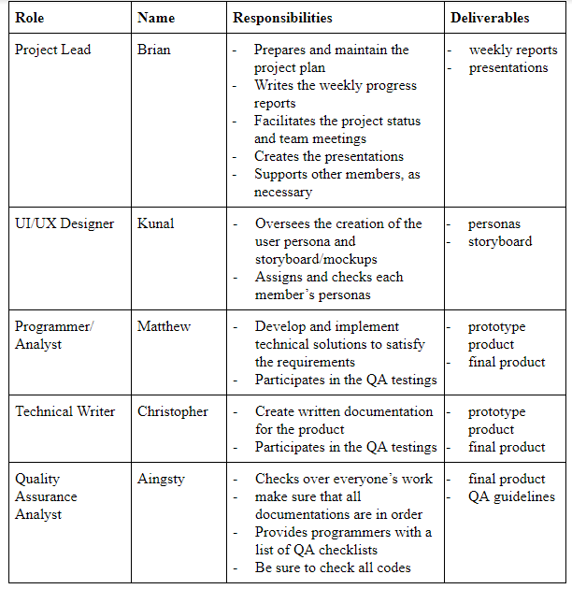
Roles
& Responsibilities
CALIFORNIA STATE UNIVERSITY LONG BEACH
Notes:
Christopher

Slide 5
CALIFORNIA STATE UNIVERSITY LONG BEACH
Solution qualities
Adaptability: the web app will function to any type of web browser, OS, and displays, including mobile devices
When the application gains popularity, maintenance of a larger database is needed
Security from unwanted access
Username, password, multi-factor authentication
User privacy is always kept hidden and private
Easy to understand layout with options such as searches and favorite lists.
Notes:
Aingty

Slide 6
CALIFORNIA STATE UNIVERSITY LONG BEACH
Risks
Deadlines!!! - Our focus will be on making sure we meet the deadlines so that any unexpected outcome can be handled
Leaving team members - prepare for unexpected team member’s disappearances. Workload will increase, thus it is necessary to constantly be prepared to take over as a team
Notes:
Brian

Slide 7
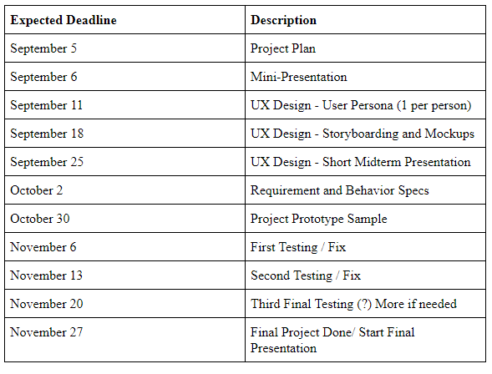
CALIFORNIA STATE UNIVERSITY LONG BEACH
Project Timeline
Notes:
Brian

